Slide 1
Hardware accelerator to speed up packet processing in NDN router
Authors: | Weiwen Yu, Derek Pao
Publisher: | 2016 Computer Communication
Presenter: | Tzu-Chieh, Lin
Date: | 106/09/27

Slide 2
INTRODUCTION
Named Data Networking (NDN) is a new network architecture. Packets under the NDN framework are identified by names , instead of the IP address/port number in the conventional Internet Protocol .
The name in an NDN packet can name anything – an endpoint, a data chunk in a movie or a book.
There are two types of packets in NDN network: Interest packet and Data packet.

Slide 3
NDN Architectural
NDN
Network
Consumer
Interest Packet
Data Packet

Slide 4
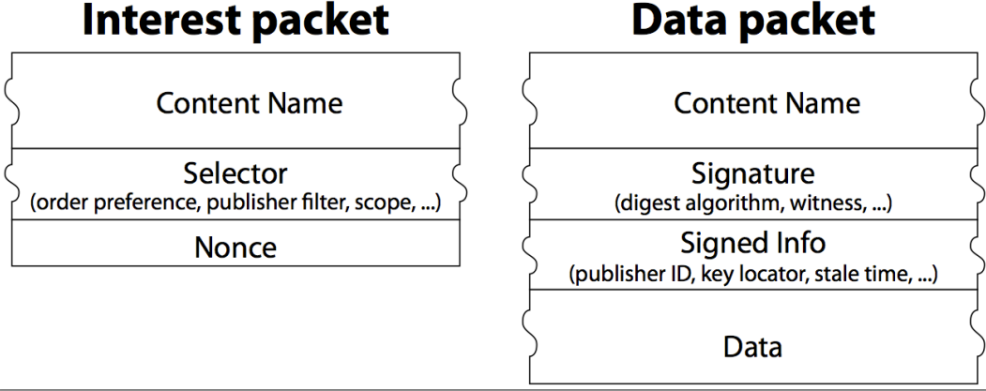

Slide 5
Name
A video produced by PARC.com may have the name
/parc.com/videos/WidgetA.mpg
Segment 3 of version 1 of the video might be named
/parc.com/videos/WidgetA.mpg/1/3

Slide 6
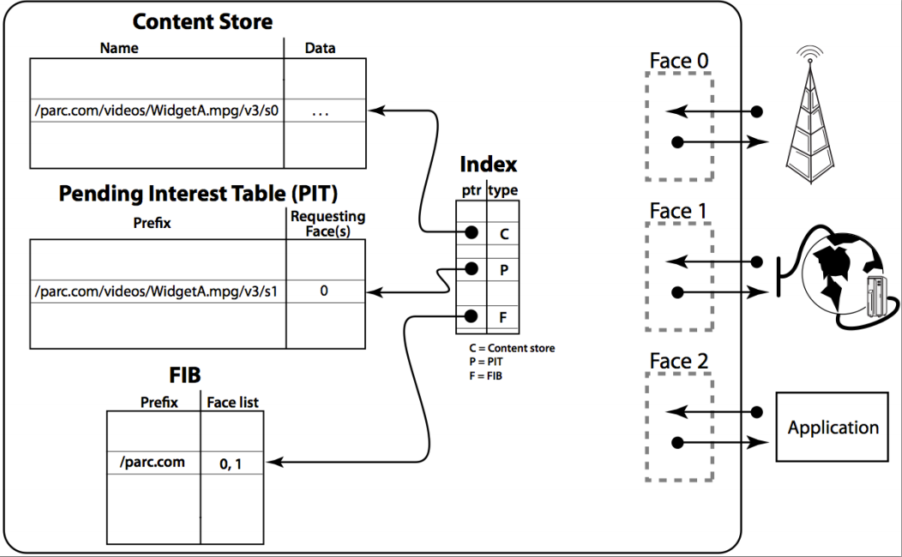
Forwarding Information Base

Slide 7
Packet processing challenges in NDN
A fundamental difference between the packet processing in NDN and conventional TCP/IP routers is that NDN requires stateful processing, whereas TCP/IP only requires stateless processing.
The stateful processing requirement of NDN leads to per-packet update to the PIT and the CS tables.
Hardware should be able to execute update and lookup operations to the PIT/CS tables with the same efficiency.

Slide 8
Related work
DiPIT and MaPIT are two software-base implementation PIT table using BF(Bloom Filter). Yuan and Crowley present a software implementation of the PIT using d-left hash table.
These software-base implementation can only achieve packet processing rate of a few MPPS (million packets per second).
In this paper, we shall present a hardware accelerator that can improve the packet processing rate of the PIT up to 60 MPPS, and reduce the workload of FIB lookup significantly.

Slide 9
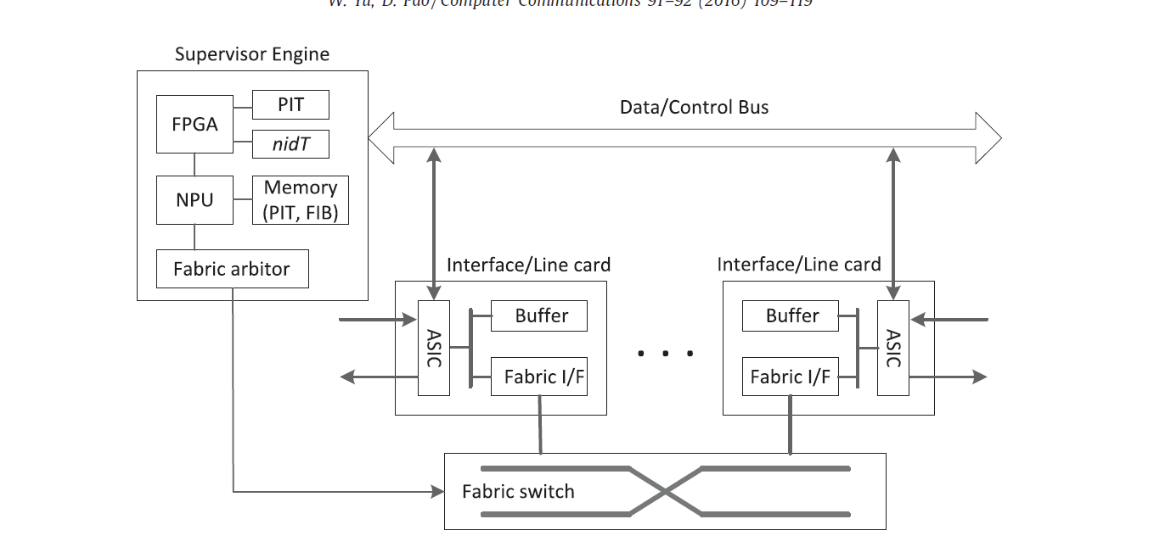
System Architecture

Slide 10
nid & sn
Divide the packet name into two logical parts, the content name, and the segment number (sn).
For example, /parc.com/videos/WidgetA.mpg/1/3 have content name /parc.com/videos/WidgetA.mpg/1 and segment number 3.
Variable-length name is converted to a fixed-length 64-bit name ID (nid) using hash function.
hash(/parc.com/… , 3) = 30 , then (nid, sn) = (30, 3)

Slide 11
PIT & nidT
The software and hardware maintain its own copy of the PIT and nidT.
The hardware table contains only the essential data fields to support the search and update operations.

Slide 12
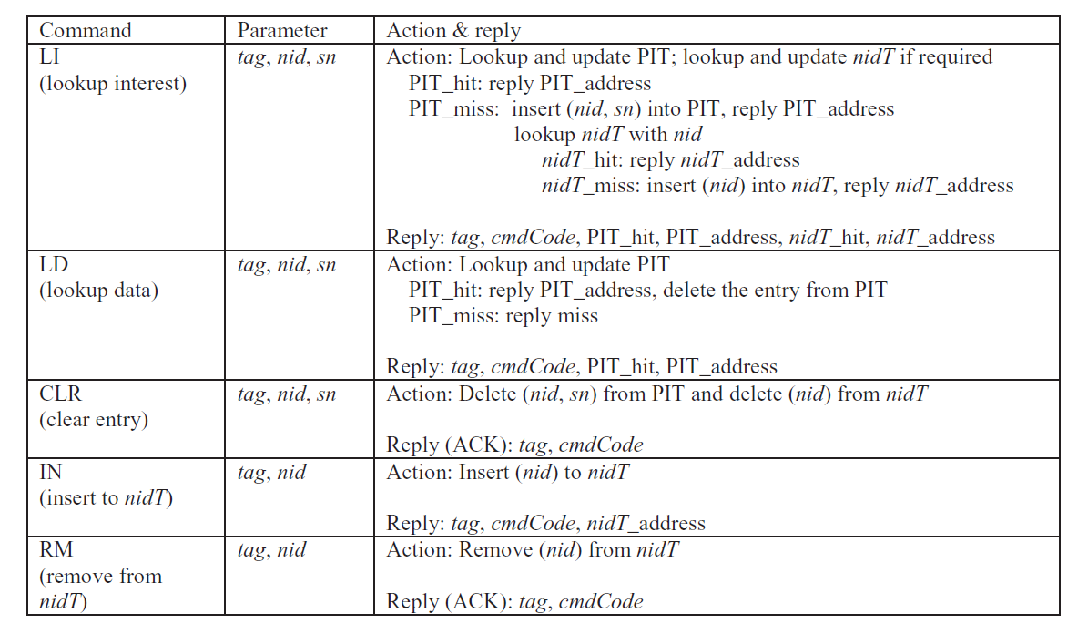

Slide 13
Received Interest Packet
 | nid | sn | face list | other info
0x00 | 30 | 0 | 0,1 | …
0x01 | 30 | 1 | 0,1 | …
0x10 | 46 | 0 | 2 | …
0x11 | 100 | 5 | 3 | …
 | nid | sn
0x00 | 30 | 0
0x01 | 30 | 1
0x10 | 46 | 0
0x11 | 100 | 5
NPU
LI(30, 0)
FPGA
(hit, 0x00, ..)

Slide 14
Received Data Packet
 | nid | sn | face list | other info
0x00 | 30 | 0 | 0,1 | …
0x01 | 30 | 1 | 0,1 | …
0x10 | 46 | 0 | 2 | …
0x11 | 100 | 5 | 3 | …
 | nid | sn
0x00 | 30 | 0
0x01 | 30 | 1
0x10 | 46 | 0
0x11 | 100 | 5
NPU
LD(30, 0)
FPGA
(hit, 0x00, ..)

Slide 15
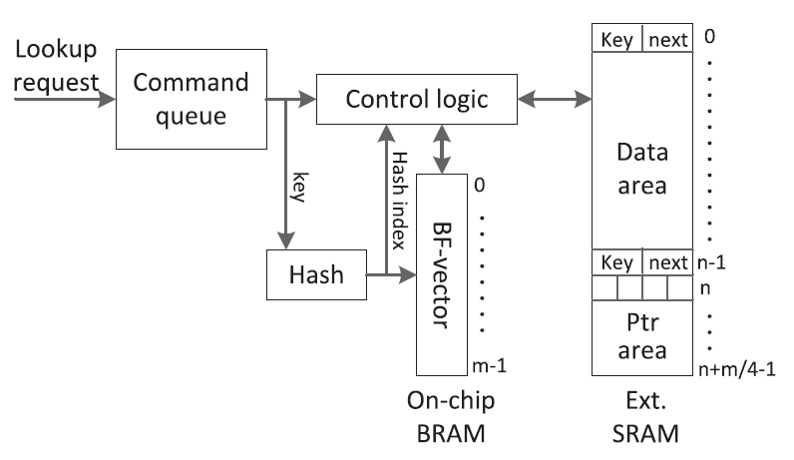
Lookup Table

Slide 16
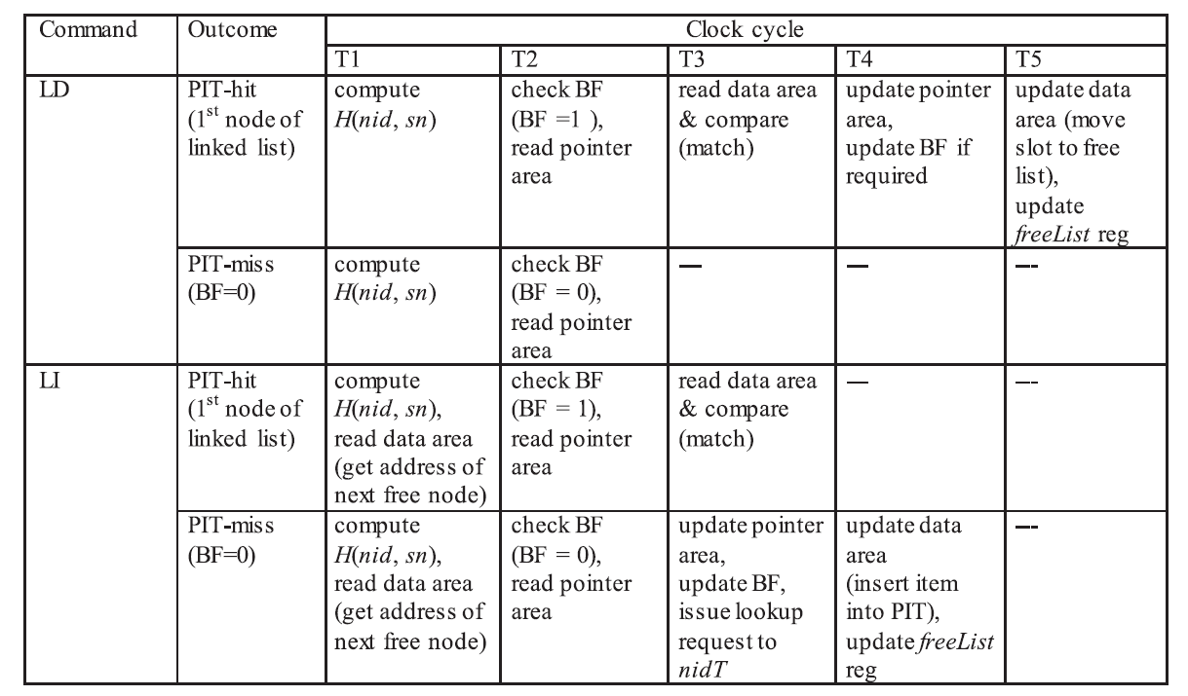

Slide 18
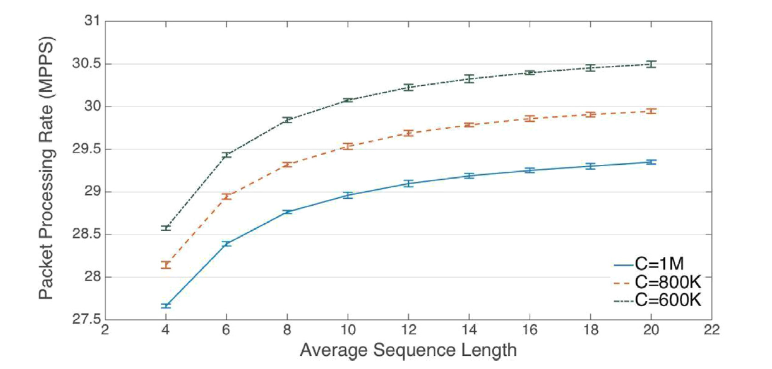

Slide 19
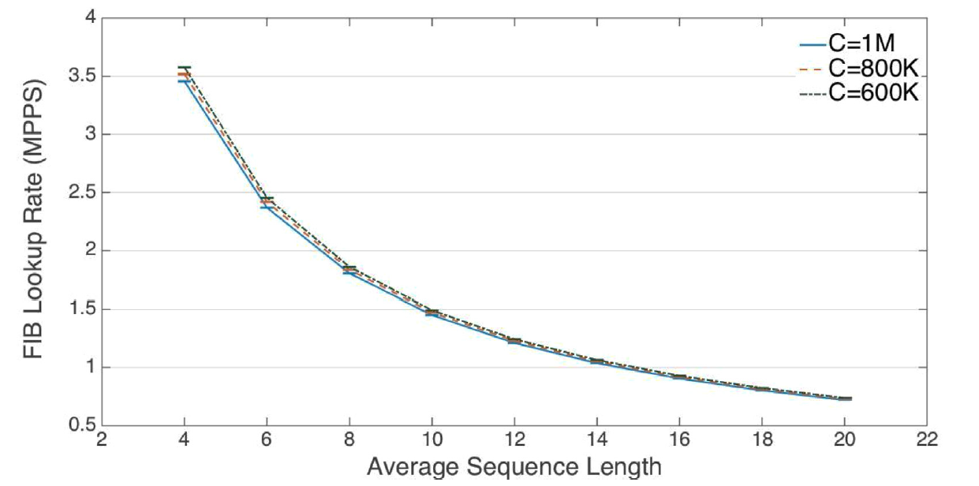

Slide 20
